Slide 1

UNIX Programming
Chapter 3 – System Programming Concepts

Slide 2
3. System Programming Concepts
This chapter covers various topics that are prerequisites for system programming.
We begin by introducing system calls and detailing the steps that occur during their execution. We then consider library functions and how they differ from system calls, and couple this with a description of the (GNU) C library
Whenever we make a system call or call a library function, we should always check the return status of the call in order to determine if it was successful. Therefore, these checks will be shown and explained in detail.

Slide 3
3.1 System Calls
A system call is a controlled entry point into the kernel, allowing a process to request that the kernel perform some action on the process’s behalf.
The kernel makes a range of services accessible to programs via the system call application programming interface (API).
These services include, for example, creating a new process, performing I/O, and creating a pipe for interprocess communication.

Slide 4
3.1 System Calls
From a programming point of view, invoking a system call looks much like calling a C function. However, behind the scenes, many steps occur during the execution of a system call

Slide 5
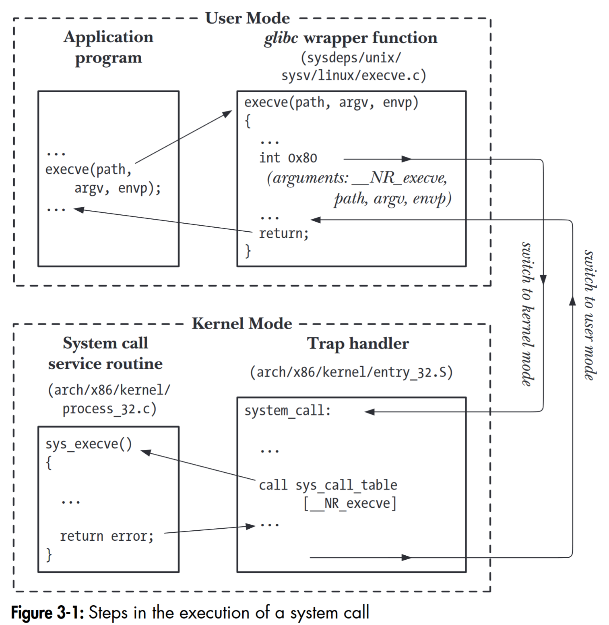

Slide 6
3.2 Library Functions
A library function is simply one of the multitude of functions that constitutes the standard C library.
The purposes of these functions are very diverse, including such tasks as opening a file, converting a time to a human-readable format, and comparing two character strings.
Many library functions don’t make any use of system calls. On the other hand, some library functions are layered on top of system calls.

Slide 7
3.2 Library Functions
For example, the fopen() library function uses the open() system call to actually open a file.
Often, library functions are designed to provide a more caller-friendly interface than the underlying system call.
For example, the printf() function provides output formatting and data buffering, whereas the write() system call just outputs a block of bytes.
Similarly, the malloc() and free() functions perform various bookkeeping tasks that make them a much easier way to allocate and free memory than the underlying brk() system call.

Slide 8
3.3 The Standard C Library, The GNU C Library
There are different implementations of the standard C library on the various UNIX implementations. The most commonly used implementation on Linux is the GNU C library
Sometimes, we need to determine the version of glibc on a system. From the shell, we can do this by running the glibc shared library file as though it were an executable program. When we run the library as an executable, it displays various text, including its version number

Slide 9
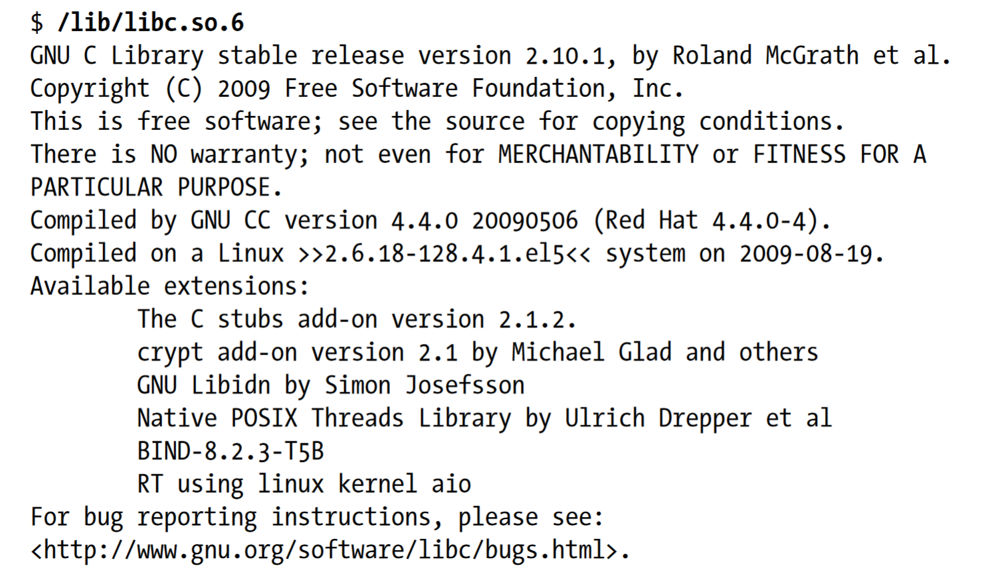

Slide 10
3.4 Handling Errors from System Calls and Library Functions
Almost every system call and library function returns some type of status value indicating whether the call succeeded or failed. This status value should always be checked to see whether the call succeeded.
If it did not, then appropriate action should be taken—at the very least, the program should display an error message warning that something unexpected occurred.

Slide 11
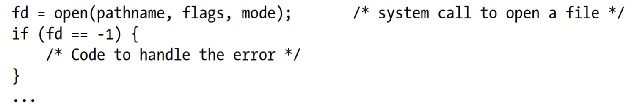
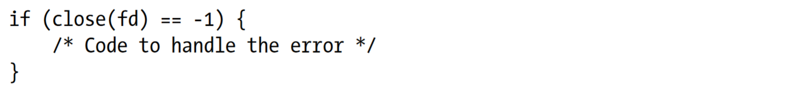
Handling system call errors
The manual page for each system call documents the possible return values of the call, showing which value(s) indicate an error. Usually, an error is indicated by a return of –1. Thus, a system call can be checked with code such as the following:

Slide 12
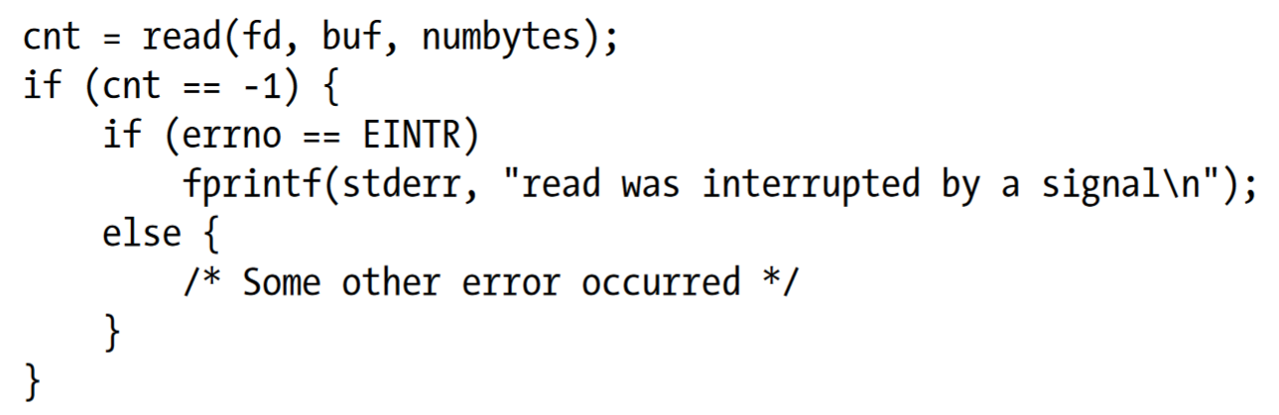
Handling system call errors
When a system call fails, it sets the global integer variable errno to a positive value that identifies the specific error. Including the <errno.h> header file provides a declaration of errno, as well as a set of constants for the various error numbers
Here is a simple example of the use of errno to diagnose a system call error:

Slide 13
Handling system call errors
Successful system calls and library functions never reset errno to 0, so this variable may have a nonzero value as a consequence of an error from a previous call. Therefore, when checking for an error, we should always first check if the function return value indicates an error, and only then examine errno to determine the cause of the error.
A common course of action after a failed system call is to print an error message based on the errno value. The perror() and strerror() library functions are provided for this purpose

Slide 14
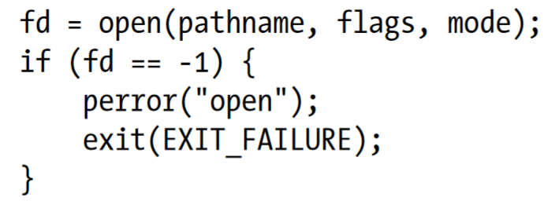
Handling system call errors
The perror() function prints the string pointed to by its msg argument, followed by a message corresponding to the current value of errno.
A simple way of handling errors from system calls would be as follows:

Slide 15
Handling system call errors
The strerror() function returns the error string corresponding to the error number given in its errnum argument
The string returned by strerror() may be statically allocated, which means that it could be overwritten by subsequent calls to strerror().
If errnum specifies an unrecognized error number, strerror() returns a string of the form Unknown error nnn. On some other implementations, strerror() instead returns NULL in this case.

Slide 16
3.5 Notes on the Example Programs
Common Header File
It is the header file used by nearly every program in this book. This header file includes various other header files used by many of the example programs, defines a Boolean data type, and defines macros for calculating the minimum and maximum of two numeric values. Using this header file allows us to make the example programs a bit shorter.

Slide 17
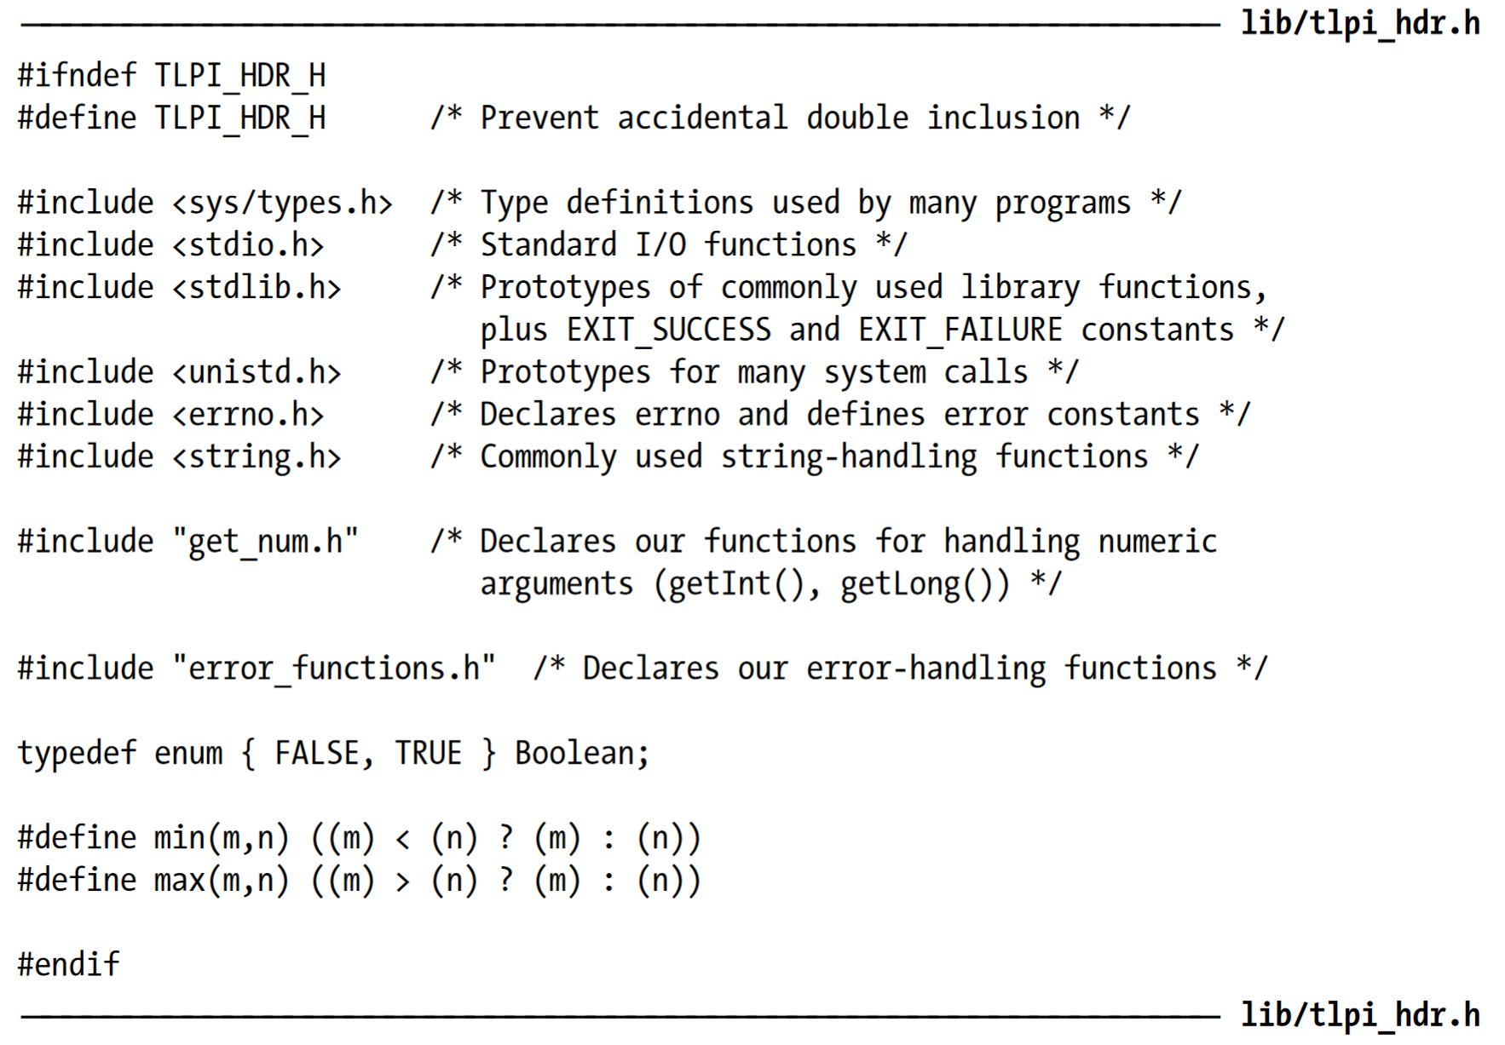

Slide 18
3.5 Notes on the Example Programs
Error-diagnostic functions
To simplify error handling in our example programs, we use the error-diagnostic functions with some basic void declarations.

Slide 19
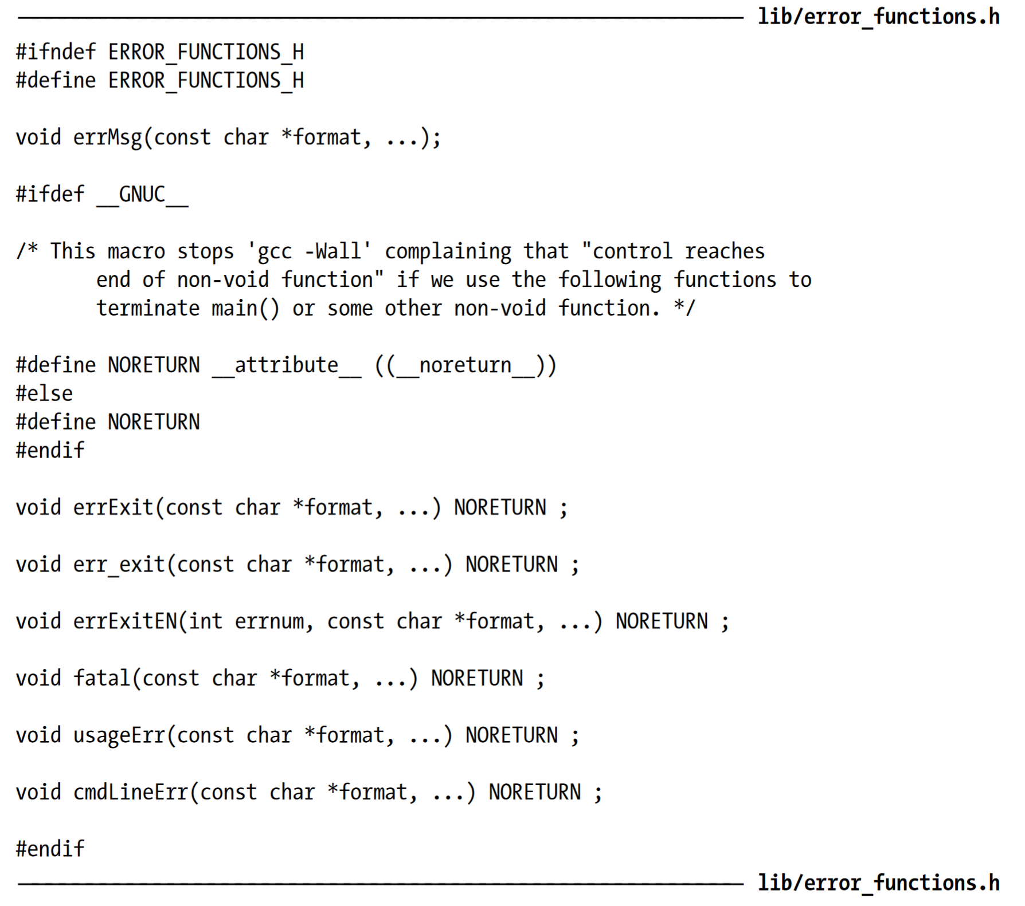

Slide 20
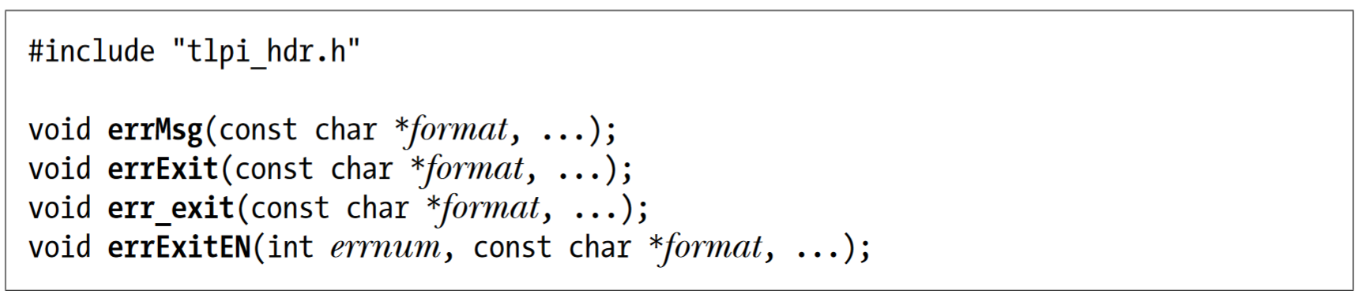
3.5 Notes on the Example Programs
To diagnose errors from system calls and library functions, we use errMsg(), errExit(), err_exit(), and errExitEN()

Slide 21
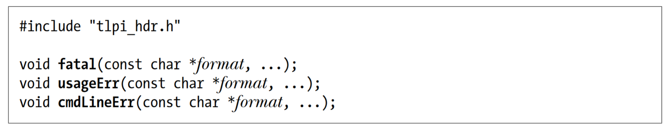
3.5 Notes on the Example Programs
To diagnose other types of errors, we use fatal(), usageErr(), and cmdLineErr().

Slide 22
3.5 Notes on the Example Programs
To diagnose other types of errors, we use fatal(), usageErr(), and cmdLineErr().

Slide 23
3.7 Summary
System calls allow processes to request services from the kernel. Even the simplest system calls have a significant overhead by comparison with a user-space function call, since the system must temporarily switch to kernel mode to execute the system call, and the kernel must verify system call arguments and transfer data between user memory and kernel memory.
The standard C library provides a multitude of library functions that perform a wide range of tasks. Some library functions employ system calls to do their work; others perform tasks entirely within user space. On Linux, the usual standard C library implementation that is used is glibc
Most system calls and library functions return a status indicating whether a call has succeeded or failed. Such status returns should always be checked.
We introduced a number of functions that we have implemented for use in the example programs in this book. The tasks performed by these functions include diagnosing errors and parsing command-line arguments.

Slide 24
Additional Resources
Linux File System/Structure Explained!

